Slide 1

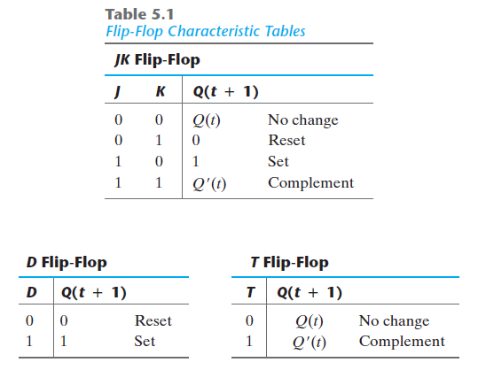
The characteristic tables of three types of flip-flops are presented in Table 5.1. They define the next state (i.e., the state that results from a clock transition) as a function of the inputs and the present state.
Q(t) denotes the state of the flip-flop immediately before the clock edge, and Q(t + 1) denotes the state that results from the clock transition.

Slide 2
